Slide 1

Surface engineering for automotive engine components
Marcin Tomkiewicz

Slide 2
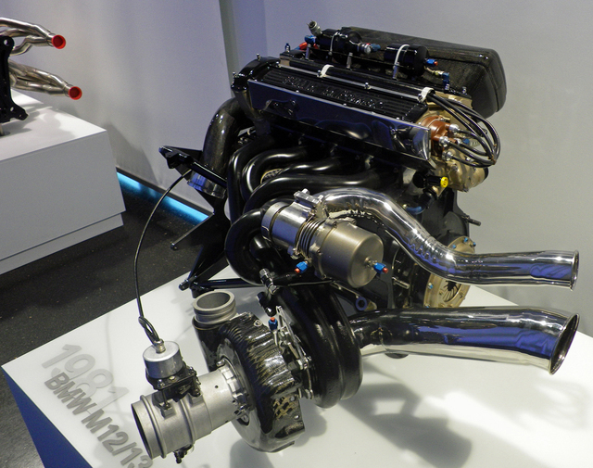
Automotive engine components and their conditions during operation

Slide 3
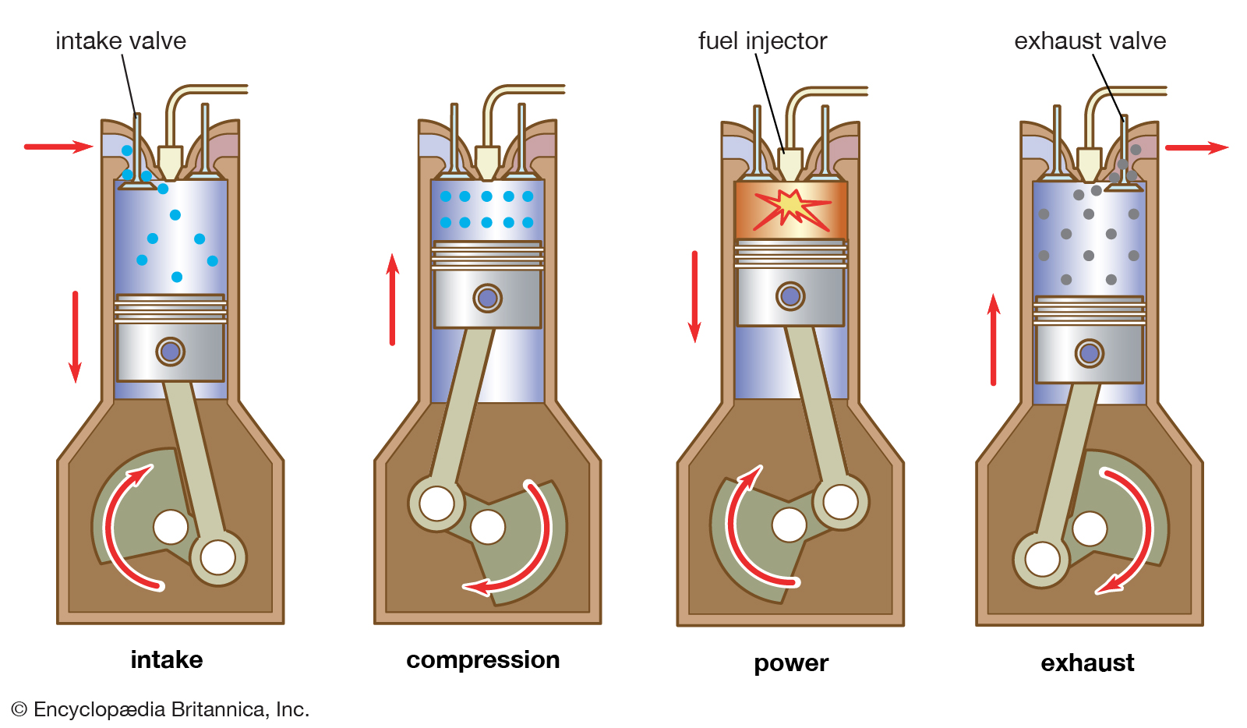
Conditions, that are present in internal combustion engine
High speed of rotating cylinders inside the engine block
High temperature during internal combustion of fuel
Corrosive exhaust gasses
Presence of atmospheric oxygen in combustion chamber
Soot residue from imperfect combustion
Fig. 1 Schematic of internal combustion engine cycle

Slide 4
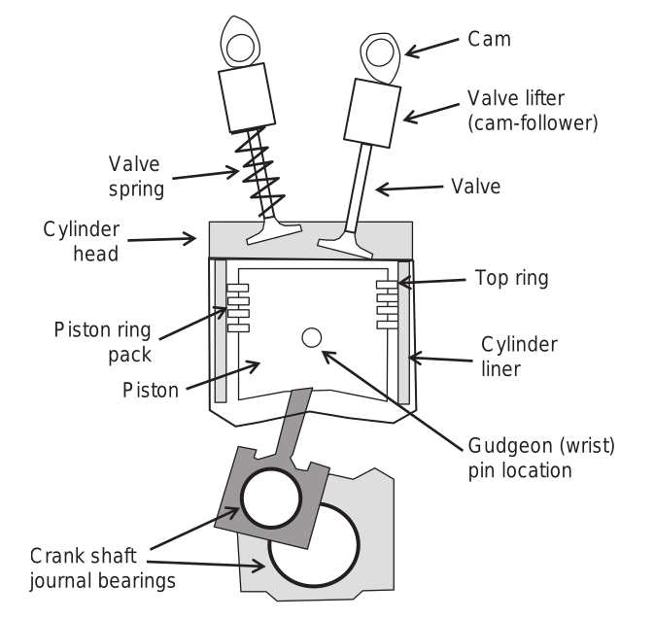
Engine components
Automotive engines have many constituent parts, many ow which operate in harsh conditions
Current development focuses on lowering friction, thus improving efficiency of the engine and on durability of each constituent part of the engine
There is also focus on decreasing the cost and environmental impact of manufacture
Fig. 2 Schematic of basic components of internal combustion engine

Slide 5
Surface engineering of engine components
Purpose of using surface engineering for ICE is to provide wear protection, while maintaining a low friction coefficient
Typical components that are engineered it this field are piston rings, cam-followers, cams, journal bearings and exhaust valves
Fig. 2 Schematic of basic components of internal combustion engine

Slide 6
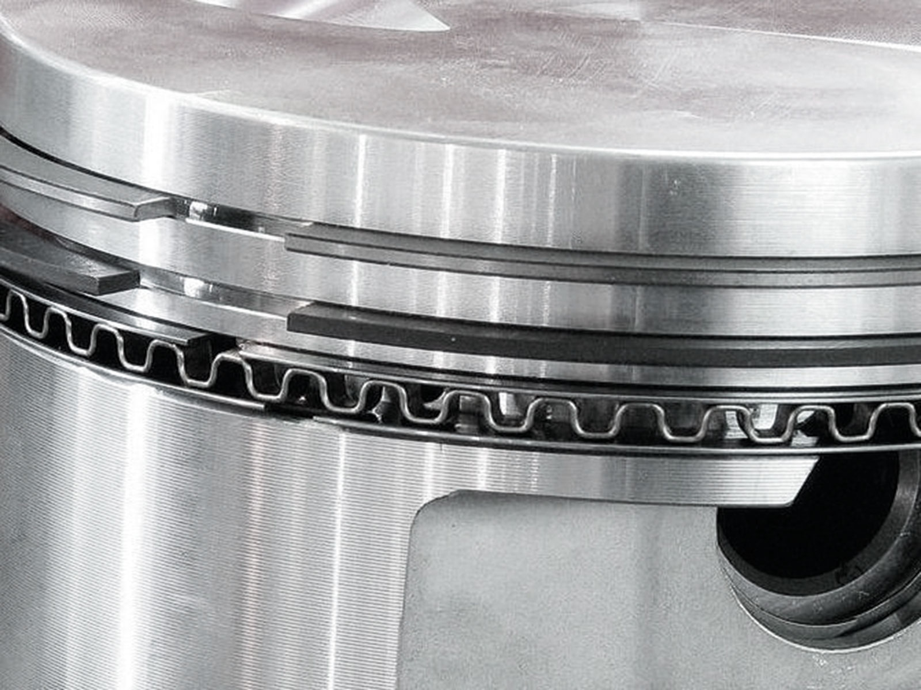
Piston rings

Slide 7
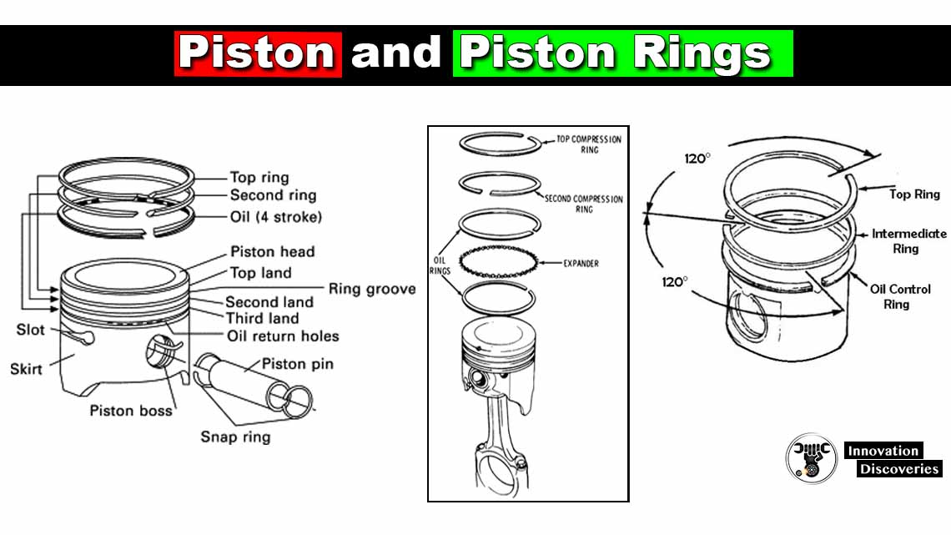
Piston rings
It is a metallic ring, which is attached to outer diameter of a piston in an engine
Main functions of it are:
- sealing the combustion chamber so that there is minimal loss of gasses - improvement of heat transfer between cylinder and cylinder wall - maintaining proper quality of oil below cylinder head - regulating engine oil consumption by scraping oil from cylinder walls
Fig. 3 Schematic of piston rings and their placement on piston head

Slide 8
Piston rings
One of the most important sliding contacts is that of the piston ring/cylinder liner contact
Ring that is exposed the most, and thus is the most important is the top one
It recieves a range of lubrication regimes, while being exposed to exhaust and atmospheric gasses
Fig. 3 Schematic of piston rings and their placement on piston head

Slide 9
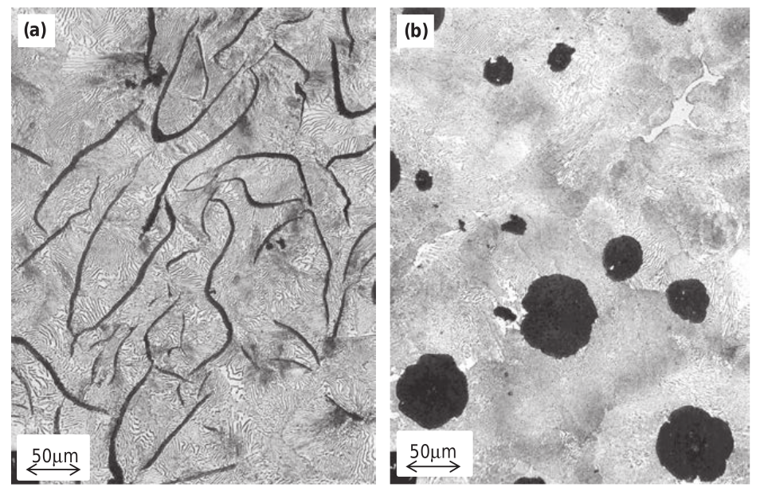
Materials for manufacture piston rings
Originally, they were made of flake graphitic cast iron and spheroidal graphitic cast iron
Both of these types can be heat treated to substitute pearlitic structure to tempered martensite, comprised with fine grained ferrite and cementite
For more demanding applications martensitic stainless steels are used. These steels have high chromium content (around 18%)
Fig. 4 Microstructures of (a) flake graphitic cast iron and (b) spheroidal graphitic cast iron

Slide 10
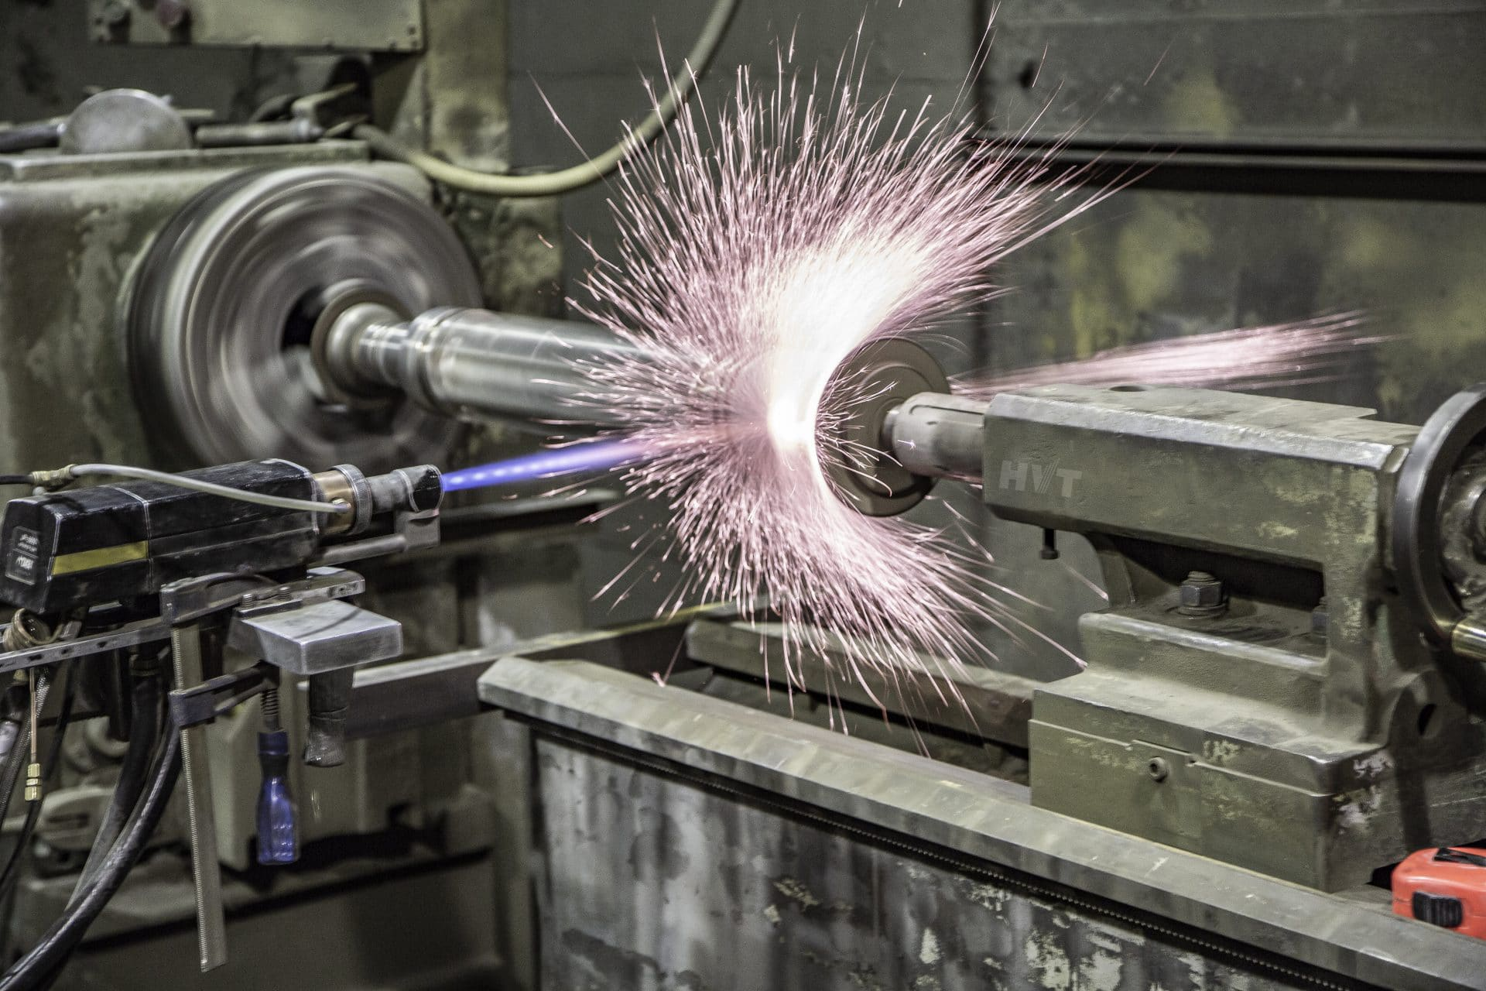
Requirements for surface engineered piston rings
High bending fatigue endurance
High abrasion resistance and fracture toughness
High oxidation resistance
The elimination of scuffing (material transfer)
The sustainment of low friction (µ<0.1)
High thermal shock (fracture) resistance
Excellent bonding between the substrate and the treated surface layer
Resistance to grain pull-out (cohesive failure)
Fig. 5 High Velocity Oxygen Fuel coating

Slide 11
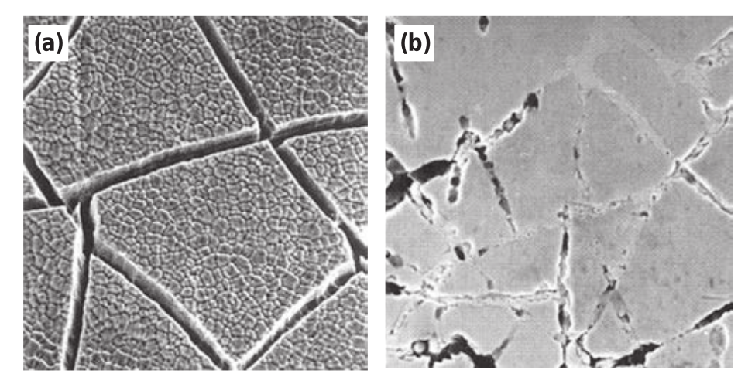
Chromium electroplating and flame spraying Molybdenum
Many variants of chromium and molybdenum coating were developed in XX century with different crack densities and surface finishes
Chromium and molybdenum coatings provide good protection from oxidation wear and reduce metal transfer between ring and cylinder wall
Unfortunately, it is less than satisfactory for diesel engine applications, because of increased sooting in this engine type
Fig. 6 Surface with electroplated electro-etched Cr (a) before and (b) after use

Slide 12
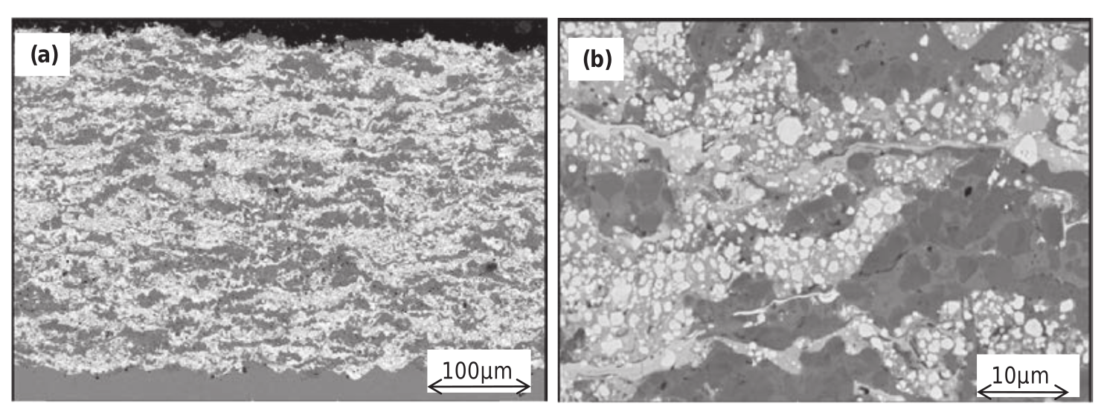
Ceramic-metal coatings
By the mid 1980s wide range of spray coating materials were developed and inroduced into mass production for diesel engines
These systems of coatings are better suited for highly abrasive conditions found in these engines. They have a higher cohesive strength and better bonding to cast iron substrate
Unfortunately process of coating is relatively expensive with losses of up to more than 60% of spray powder
Fig. 7 Multiphased WC-Cr3-C2-10Ni piston ring coating in (a) low magnification (b) high magnification

Slide 13
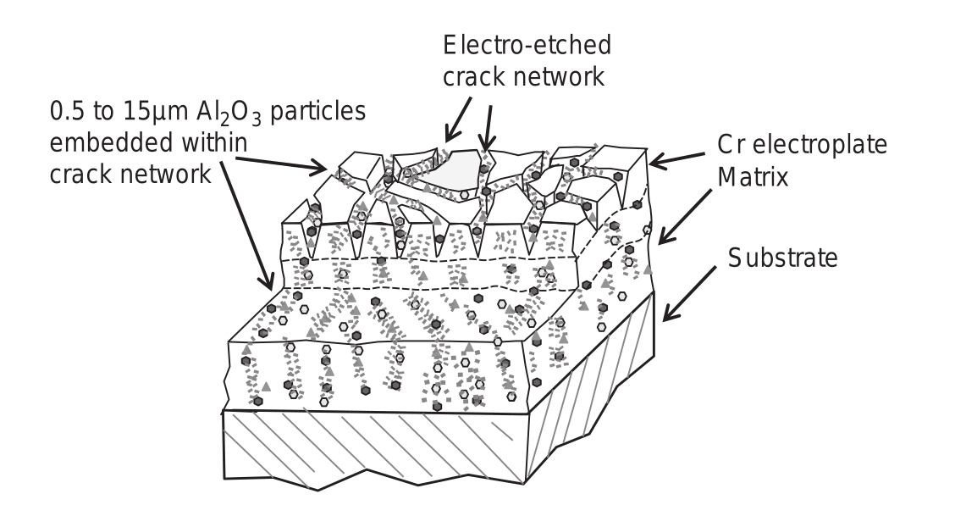
Alumina incorporated coatings
For very abrasive engine conditions ceramic composite coatings were developed
Al2O3-TiO2 system performs better than cermet coatings. High abrasion resistance is provided by alumina and titania provides its fracture toughness, while maintaining low friction coefficient
Incorporating alumina into Cr coating allows for high increase of hardness and cohesive strength of coating
Fig. 8 Schematic of Cr-Al2O3 coating

Slide 14
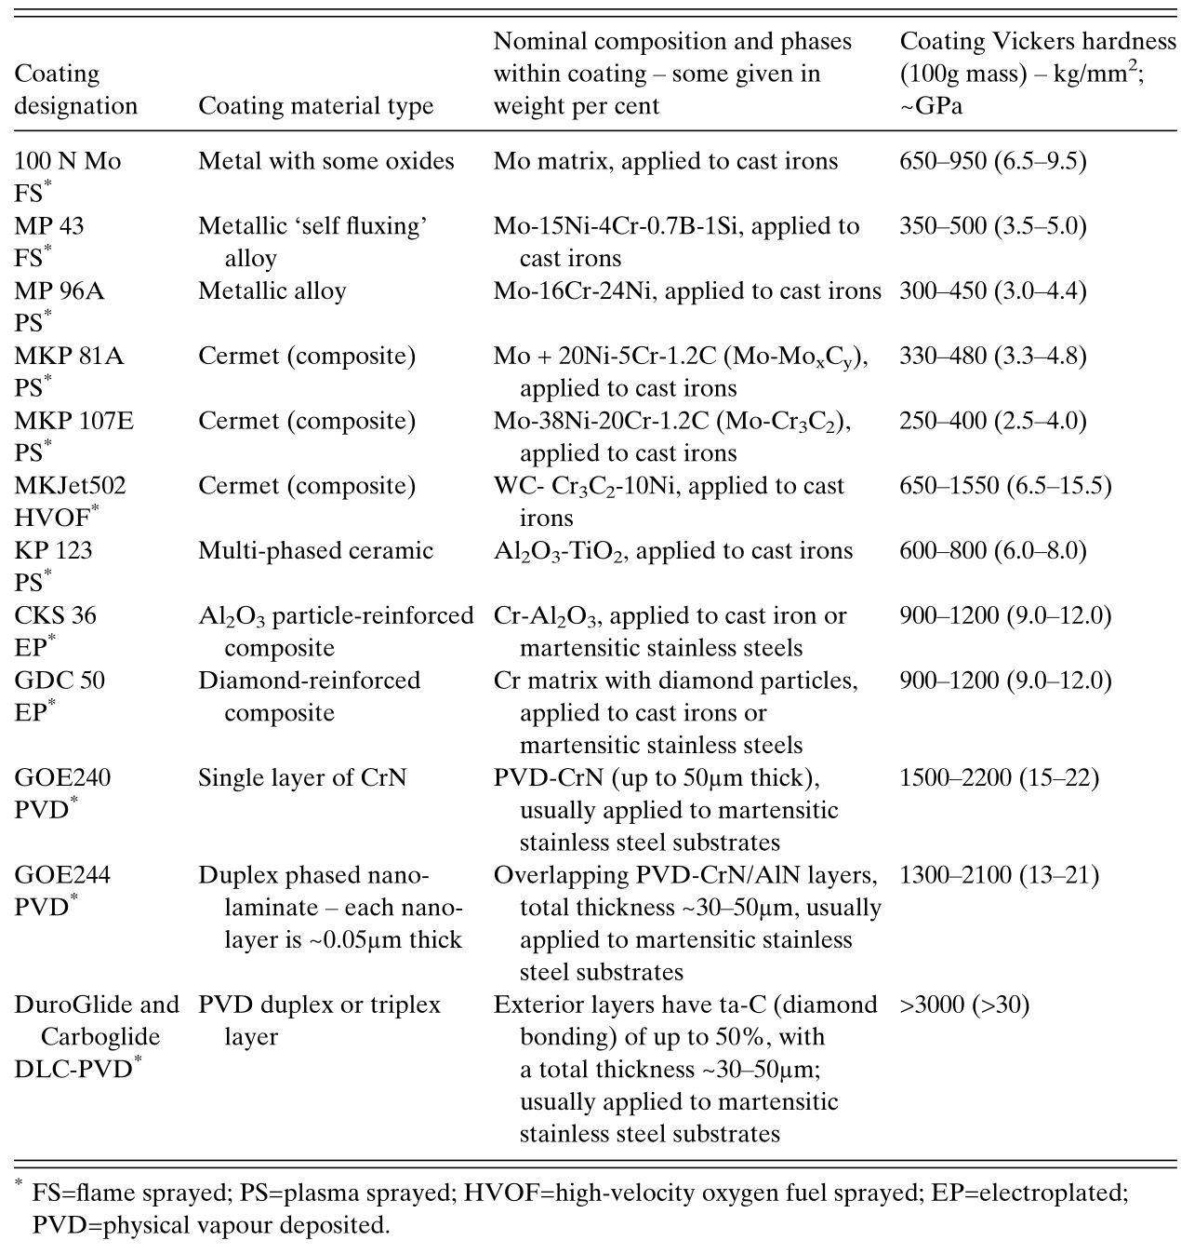
Comparison of traditionally coated piston rings
Tab. 1 Different coatings and their hardnesses
Higher hardness of the coating improves drastically life span of piston rings in the diesel engines
CKS – Cr-Al2O3 coating shows superior wear resistance
Molybdenum and molybdenum-ceramic coatings are not suited for these aplications
Petrol engines, which don't require such high hardness can be coated with molybdenum coating, which is cheaper to plate

Slide 15
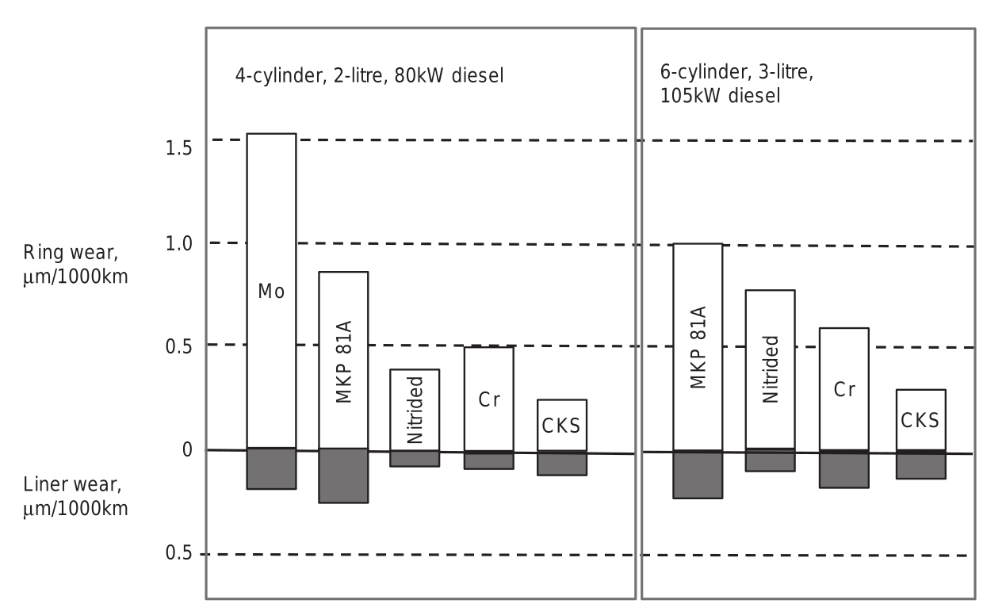
Comparison of traditionally coated piston rings
Higher hardness of the coating improves drastically life span of piston rings in the diesel engines
CKS – Cr-Al2O3 coating shows superior wear resistance
Molybdenum and molybdenum-ceramic coatings are not suited for these aplications
Petrol engines, which don't require such high hardness can be coated with molybdenum coating, which is cheaper to plate
Fig. 9 Live diesel tests comparing different coatings

Slide 16
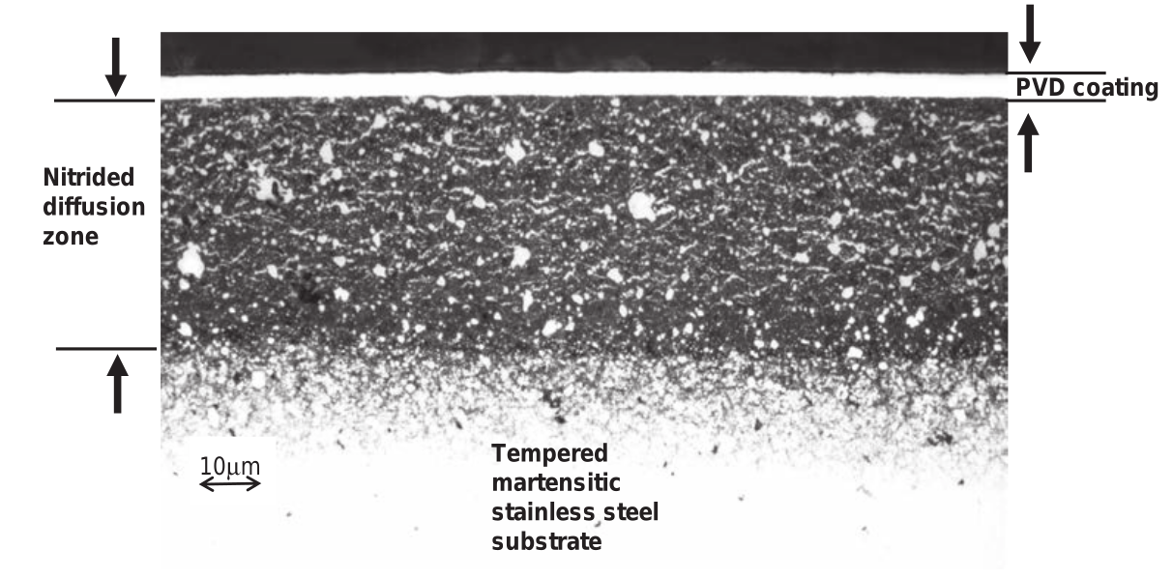
PVD coatings
Large-scale PVD coated piston rings were introduced in 2005
PVD coatings have lower thickness (50μm instead of typical 80)
Two types are being used – Chromium Nitride and Diamond Like Carbon coatings
DLC coatings exhibit superior hardness between all aforementioned coatings
Fig. 9 Schematic of PVD coated piston rings

Slide 17
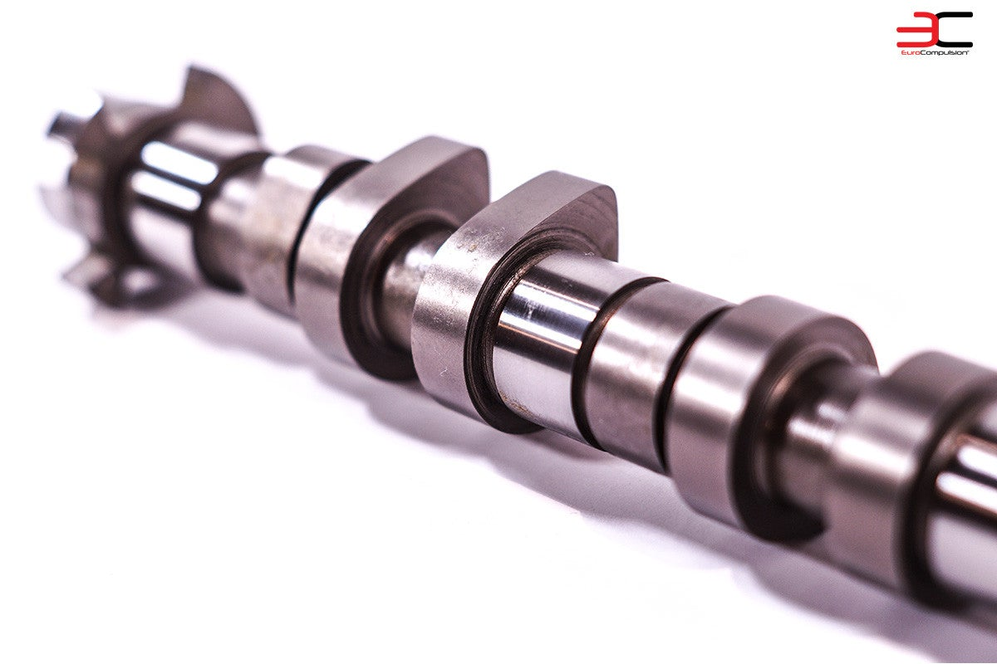
Camshaft and cam-followers

Slide 18
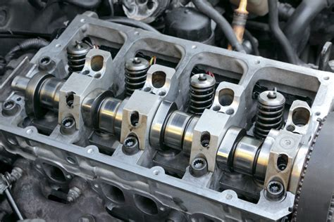
Camshaft
Camshaft is a rotational component of the engine, containing pointed cams, that converts rotational motion to reciprocal motion
In internal combustion engine it is used for timing and operating intake and exhaust valves
Most modern engines operate with camshaft in the cylinder head, but in older engines camshafts were situated in an engine block and excreted motion upwards through a pushrod
Fig. 10 Camshaft mounted in cylinder head

Slide 19
Camshaft engineering
Bulk materials haven't received a lot of attention in last years, as camshafts and cam-followers are being made still from cast iron or steels
But still, surface engineering is required to realize high rolling contact fatigue resistance, low friction and micro-abrasion wear
Operational conditions of cams are much lower than that of piston rings and typical friction levels are lower
Fig. 10 Camshaft mounted in cylinder head

Slide 20
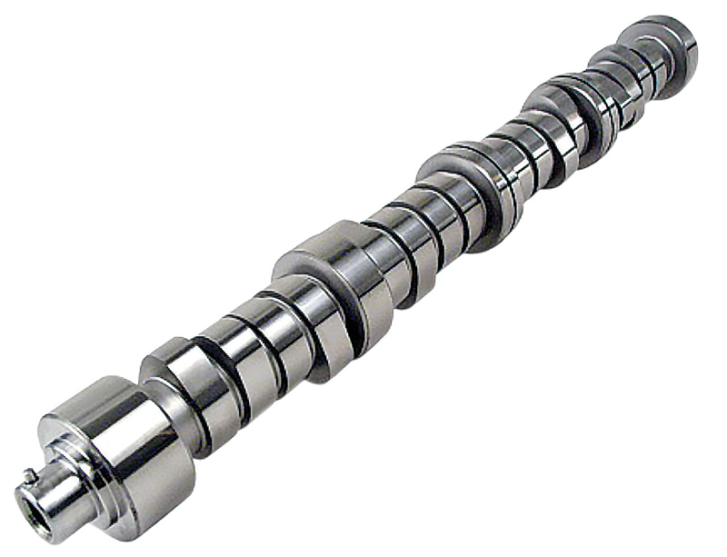
Chromium nitride coatings
Chromium nitride coatings are deposited on camshafts using PVD method
This coating improves on hardness, that can result in lower friction of rotation of camshaft
Due to its hardness microabrasion can easily lead to delamination of coating from camshaft
Fig. 11 Chromium Nitride coated camshaft

Slide 21
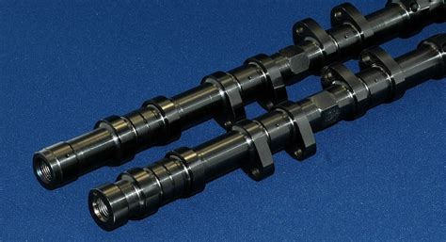
Diamond Like Coatings
Diamond-like coatings can be applied in both hydrogenated and non-hydrogenated forms
Hydrogenated DLC exhibits lower brittleness, but has lower hardness than non-hydrogenated DLC
DLC coatings can reduce friction of cam assembly up to 40% improving both power output and economy of internal combustion engine
Fig. 11 Diamond-like coated camshaft

Slide 22
Bibliography
Dearnley, P. A., "Introduction to Surface Engineering" Cambridge University Press, 2017
Kaźmierczak, A. R., "Analysis of the results from a goniometer and tribotester of a diamond derivative coating on the first piston ring of an internal combustion engine", Wear 447 (2021)
Ferreira, R., et. al. "Influence of a DLC coating topography in the piston ring/cylinder liner tribological performance" Journal of Manufacturing Process, 66 (2021)
Wan, S., et. al."Investigating the corrosion-fatigue wear on CrN coated piston rings from laboratory wear tests and field trial studies", Wear 432-433 (2019)
Dobrenizki, L., et. al"Efficiency improvement in automobile bucket tappet/camshaft contacts by DLC coatings – Influence of engine oil, temperature and camshaft speed", Surface & Coatings Technology 308 (2016)

